Slide 1
Weakly supervised object localization
Thesis midterm – 15/2/2023
Geert Goemaere

Slide 2
Content
Introduction
Research question
Method
Experiments
Next steps

Slide 3
Introduction

Slide 4

Object recognition tasks and multi-instance WSOL
WSOL
Multiple-instance WSOL
Notes:
The research topic of this thesis is called “multiple-instance weakly supervised object localization” (multiple-instance WSOL).
Let’s look at the picture to explain the topic in the field of object recognition tasks. From left to right we have:
Image classification deals with assigning a single label or category) to an image. Here the label is CAT.
Object localization deals with localizing objects in an image by indicating their bounding box. In the case of WSOL, only a single object is localized.
Object detection is the task of locating objects in an image with bounding boxes and assigning a class label for each detection.
Instance segmentation deals with assigning a class label for each pixel of an image.
In this project I will
assess the performance of specific WSOL methods for images with multiple object instances
Investigate mechanisms for those WSOL methods to improve localization of multiple object instances in images

Slide 5
Why WSOL?
Problem
Object detection achieves great performance, but …
… Requires costly human labelling of bounding boxes
Localization labels not always available or of poor quality
Solution
Weakly supervised: Only image-level labels are used to train model
Object localization based on learned features

Slide 6
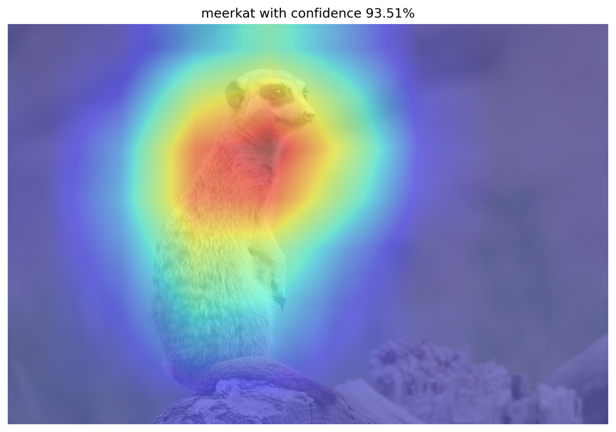
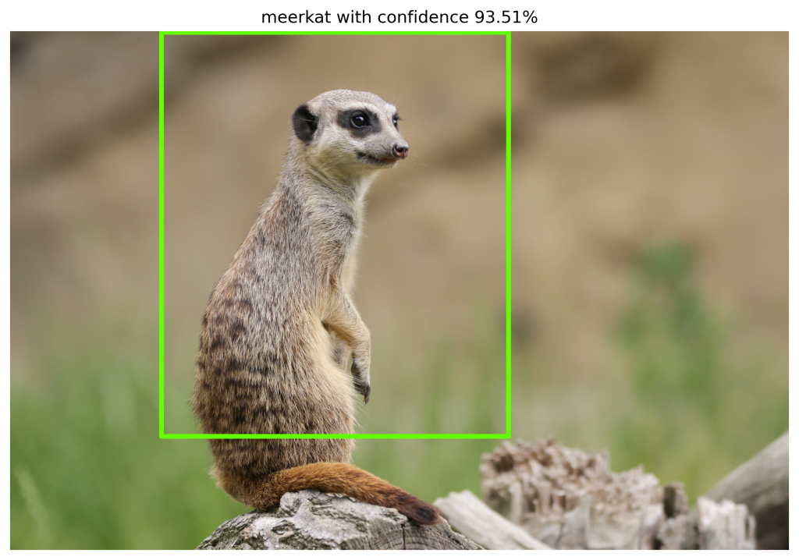
WSOL prior-art (deep learning)
Class Activation Mapping (CAM)
Baseline method
Feature activations used to localize objects
Limitations
Focus on most discriminative parts of object
Partial object localization
CAM research
Use other techniques to overcome limitations
E.g. MinMaxCAM, GradCAM, ScoreCAM

Slide 7
Problems of WSOL
Assumption of single object localization in image
No prior-art for multiple instance WSOL!
No multi-instance localization metrics
Interesting to evaluate multi-instance WSOL

Slide 8
Research question
Can we use WSOL CAM-methods to localize multiple instances of the same class?
This research
Define novel evaluation metrics for multi-instance WSOL
Benchmark multi-instance localization on specific CAM methods
Investigate improvements for multi-instance WSOL

Slide 9
Method
Multiple-instance WSOL

Slide 10
Localization based on CAM methods
CAM
Baseline method
Requires specific architecture
GradCAM
Generalization of CAM
No need for architecture modifications
ScoreCAM
Promising to localize multiple instances
MinMaxCAM
Object coverage regularization
Requires specific architecture and re-training

Slide 11
Multiple-instance WSOL - Networks
VGG16
Tends to focus on discriminative features
Used in CAM, GradCAM, ScoreCAM, MinMaxCAM
Pre-trained VGG16 model on ImageNet-1k
VGG16-GAP variant required for CAM and MinMaxCAM
ResNet50
More recent than VGG16
Used in MinMaxCAM paper
Has GAP layer: Unmodified architecture for all CAM methods

Slide 12
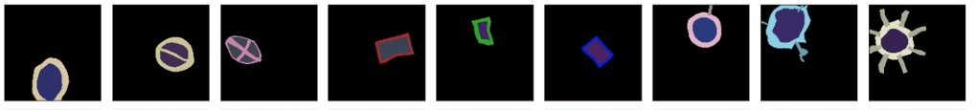

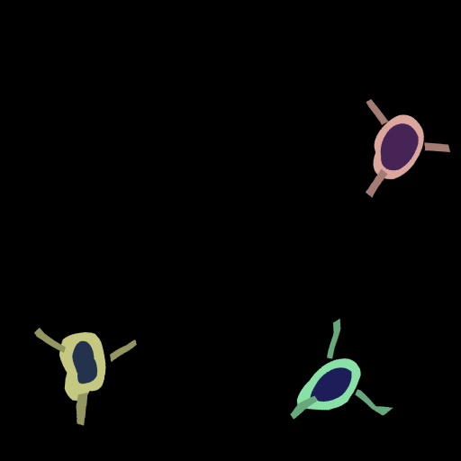
Multiple-instance WSOL – Datasets (Synthetic)
9 single-instance classes
Image size: 512x512
Fixed object instance count (1..4)
Optional background
Train-val-test split: 1000/200/200
Classification labels
Localization labels
Segmentation masks for pixel-accurate localization
Bounding boxes for instance localization

Slide 13
Multiple-instance WSOL – Datasets (ImageNet-1k)
Used in all papers: CAM, Grad-CAM, ScoreCAM, MinMaxCAM
Ground-truth labels
Image class
Instance bounding boxes
Training set: 1.2M images
Test set: 50k images
Use ImageNet-1k validation set as test set has no GT labels
Validation set: 10K images from ImageNetV2

Slide 14
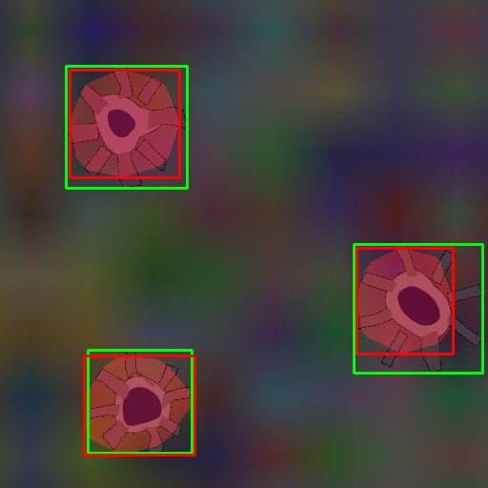
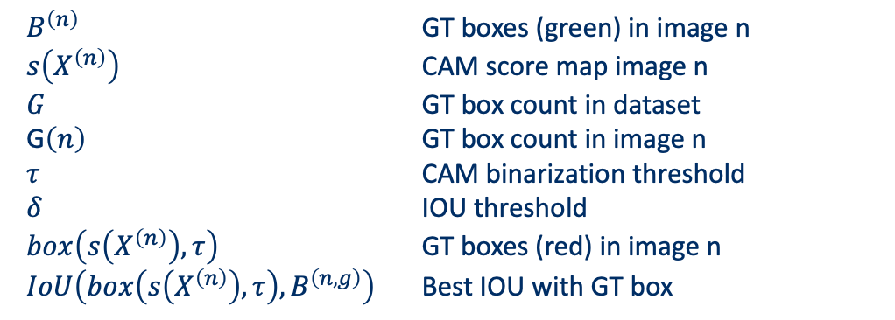
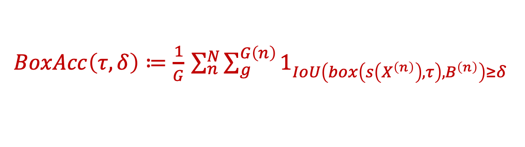
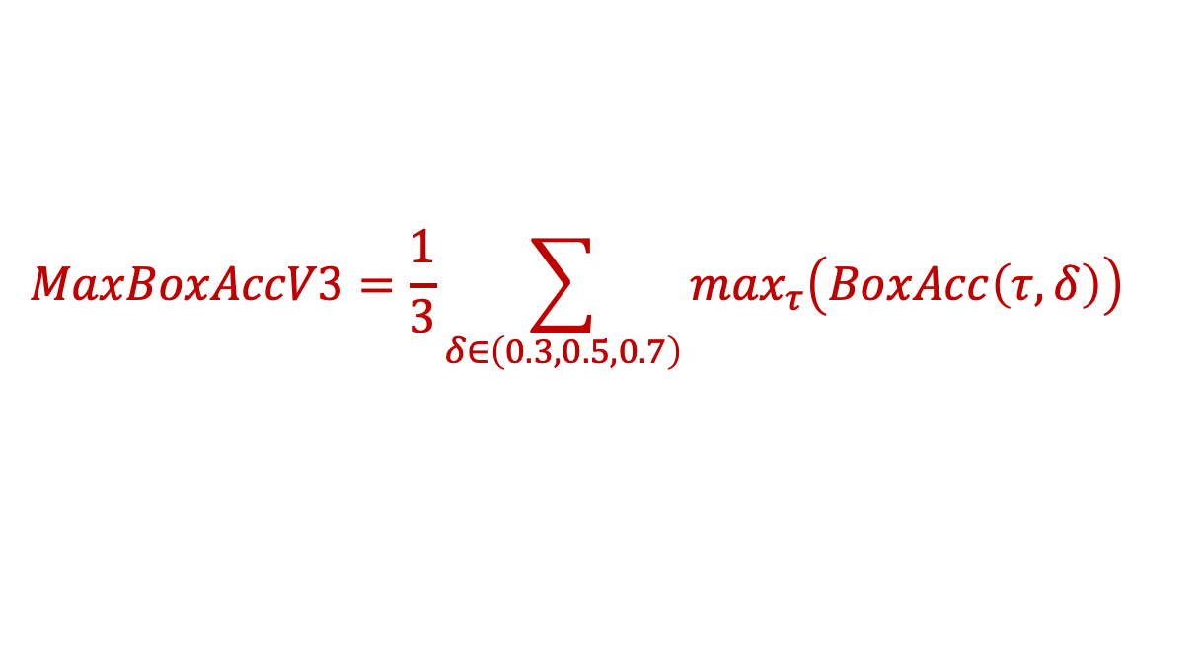
Metrics – MaxBoxAccV3
$$MaxBoxAccV3=\frac{1}{3}\sum_{δ∈\left(0.3,0.5,0.7\right)}{\max_{τ}\left(BoxAcc\left(τ,δ\right)\right)}$$
Choe et al, 2020b: MaxBoxAccV2 modified for multi-instance WSOL
$BoxAcc\left(τ,δ\right)≔\frac{1}{G}$ $\sum_{n}^{N}{\sum_{g}^{G\left(n\right)}{1_{IoU\left(box\left(s\left(X^{\left(n\right)}\right),τ\right),B^{\left(n\right)}\right)≥δ}}}$
$B^{\left(n\right)}$ GT boxes (green) in image n
$s\left(X^{\left(n\right)}\right)$ CAM score map image n
$G$ GT box count in dataset
G$\left(n\right)$ GT box count in image n
$τ$ CAM binarization threshold
$δ$ IOU threshold
$box\left(s\left(X^{\left(n\right)}\right),τ\right)$ GT boxes (red) in image n
$IoU\left(box\left(s\left(X^{\left(n\right)}\right),τ\right),B^{\left(n,g\right)}\right)$ Best IOU with GT box

Slide 15
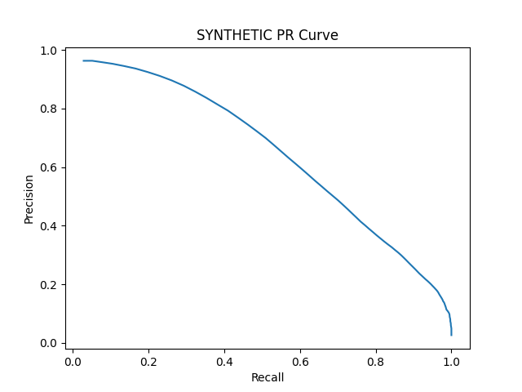

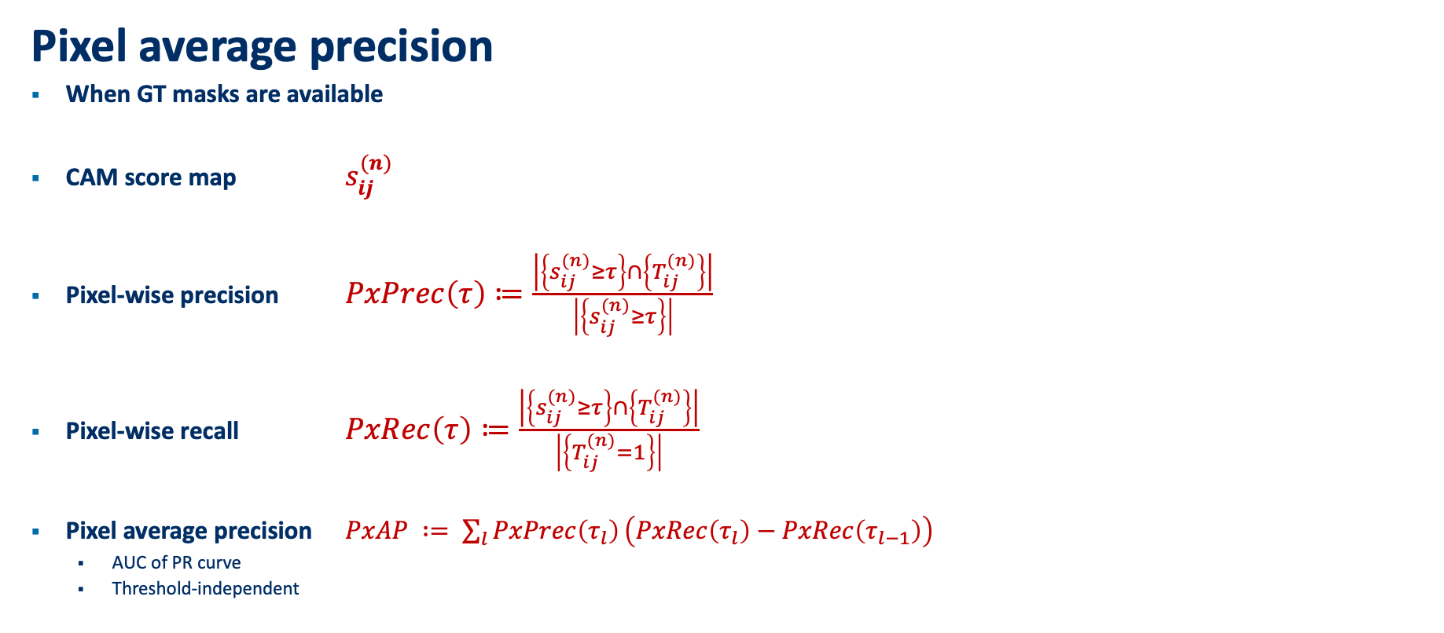
Multiple-instance WSOL - Metrics
Pixel average precision
When GT masks are available
CAM score map $s_{ij}^{(n)}$
Pixel-wise precision $PxPrec\left(τ\right)≔\frac{\left|\left\{s_{ij}^{(n)}≥τ\right\}\right.∩\left.\left\{T_{ij}^{(n)}\right\}\right|}{\left|\left\{s_{ij}^{(n)}≥τ\right\}\right|}$
Pixel-wise recall $PxRec\left(τ\right)≔\frac{\left|\left\{s_{ij}^{(n)}≥τ\right\}\right.∩\left.\left\{T_{ij}^{(n)}\right\}\right|}{\left|\left\{T_{ij}^{(n)}=1\right\}\right|}$
Pixel average precision $PxAP ∶= \sum_{l}{PxPrec\left(τ_{l}\right)}\left(PxRec\left(τ_{l}\right)−PxRec\left(τ_{l−1}\right)\right)$
AUC of PR curve
Threshold-independent

Slide 16
Multiple-instance WSOL - Improvements
Challenge
1 operational threshold to extract bounding boxes
Not all object instances of similar intensity
Proposal: Iterative bounding box extraction
Process
Image is fed to model and CAM score map is computed
Bounding boxes are extracted using operational CAM threshold.
Bounding boxes are masked (deleted, greyed, noise-filled) in image
Operational CAM threshold is lowered. Repeat 1 if no stop criteria is met.
Possible stop criteria:
No new bounding boxes are found
Predefined minimum CAM threshold is reached
Predefined drop in classification score is reached
Predefined number of iterations is reached.

Slide 17
Experiments

Slide 18
Localization performance – MaxBoxAccV3
 | VGG16-GAP (SYNTHETIC object instances) |  |  |  | VGG16 (SYNTHETIC object instances)
Method | 1 | 2 | 3 | 4 | 1 | 2 | 3 | 4
CAM | 86.83 | 45.58 | 41.50 | 15.71 | - | - | - | -
GradCAM | 86.83 | 45.58 | 41.50 | 15.71 | 74.50 | 32.08 | 30.17 | 9.17
ScoreCAM | 91.83 | 60.08 | 56.28 | 26.50 | 70.50 | 43.08 | 35.17 | 13.25
MinMaxCAM | 87.17 | 48.92 | 45.99 | 16.00 | - | - | - | -
Notes:
VGG16:
All methods
Good at single-instance
Drops significantly for 2/3 instances
Bad for 4 instances
ScoreCAM
has best MaxBoxAccV3 performance (bar VGG16 single instance)
big difference with others: 5-15 percentage points
Concurs with paper conclusions that ScoreCAM is better in localizing multiple instances
VGG16-GAP versus VGG16
VGG16-GAP significantly better performance
VGG16 has no GAP layer annd 3 FC-layers which adds complexity (more learning weights) and a less direct relationship between feature maps and classification score.

Slide 19
Localization performance – PxAP
 | VGG16-GAP (SYNTHETIC object instances) |  |  |  | VGG16 (SYNTHETIC object instances)
Method | 1 | 2 | 3 | 4 | 1 | 2 | 3 | 4
CAM | 86.87 | 63.46 | 58.40 | 29.04 | - | - | - | -
GradCAM | 86.87 | 63.46 | 58.40 | 29.04 | 67.99 | 39.15 | 41.93 | 13.05
ScoreCAM | 85.64 | 70.06 | 67.66 | 38.97 | 68.80 | 53.33 | 45.85 | 21.40
MinMaxCAM | 86.55 | 65.35 | 61.21 | 26.51 | - | - | - | -
Notes:
Similar picrture as for MaxBoxAccV3.
- ScoreCAM performs best by large margin for multiple instances.

Slide 20
Box Accuracy at varying CAM thresholds (IOU 50)
Notes:
BoxAcc for 1, 2, 3, 4 instance datasets
1 instance: All CAM methods perform similarly, outperformed by ScoreCAM
2,3,4: ScoreCAM performance margin over others even more pronounced
Optimal CAM threshold similar for all methods

Slide 21
Precision-Recall at varying CAM thresholds
Notes:
PR-Curves at varying CAM thresholds:
Allows us to choose preferred operating thresholds that provides the best precision-recall trade-off
1 instance: similar performance for all methods
2,3,4 instance:
ScoreCAM outperforms rest
AUC drops significantly

Slide 22
Learning curves
Observations
Example: MinMaxCAM for VGG16-GAP SYNTHETIC (1-instance)
Classification training hurts localization performance
Bests localization after few training epochs
Drops when classification performance converges
More accurate classification may focus on most discriminative parts
In line with Choe et al, 2020b findings

Slide 23
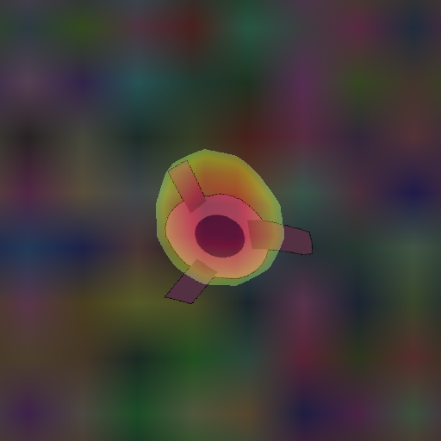
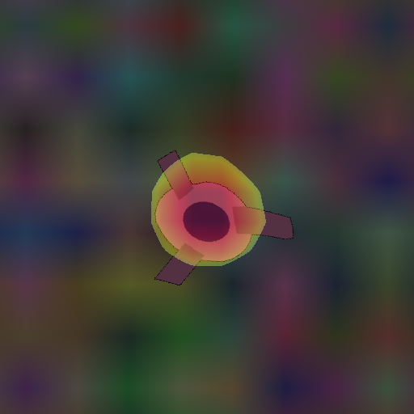
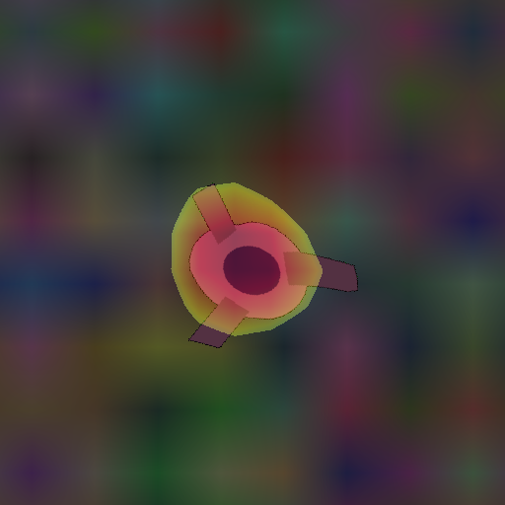
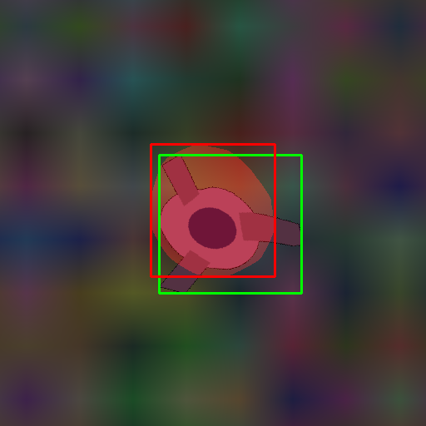
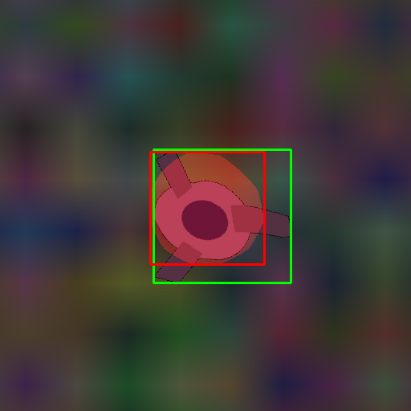
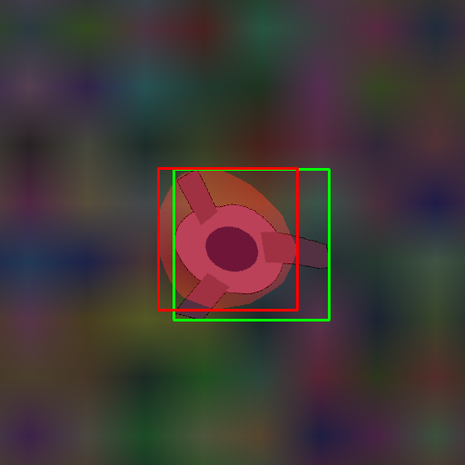
Qualitative analysis: SYNTHETIC – 1 instance
CAM (test119)
MinMaxCAM
ScoreCAM
Notes:
Single instance performance seems similar for all CAM methods
MinMaxCAM: slightly worse. May not be regularized enough.

Slide 24



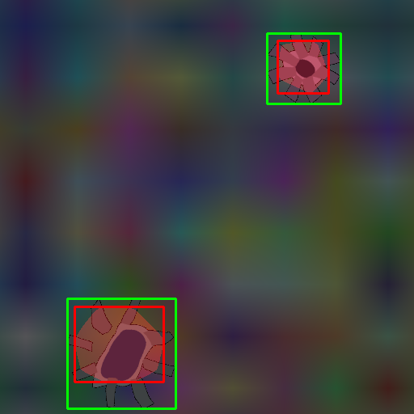
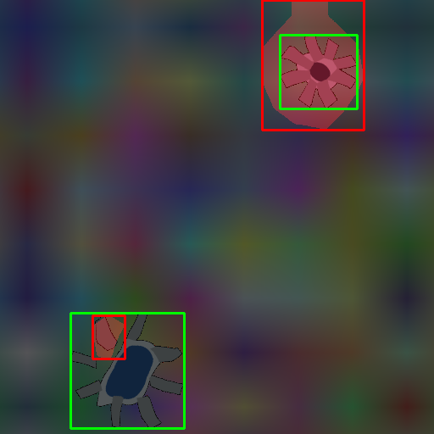
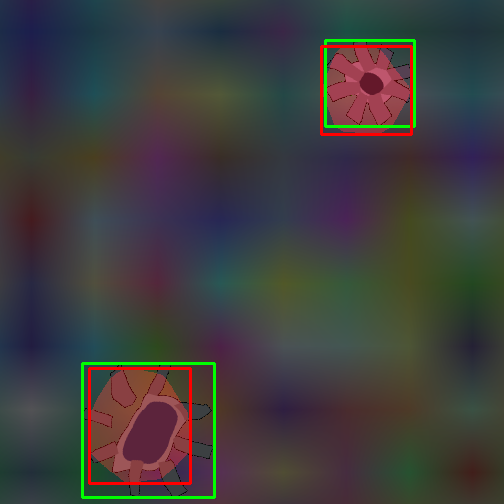
Qualitative analysis: SYNTHETIC – 2 instances
CAM (test102)
MinMaxCAM
ScoreCAM
Notes:
CAM focus on most discriminative features and underfits instances
MinMaxCAM: Overfitting 1 instance, partly fitting other instance
ScoreCAM more accurately loalizes multiple instances
A score-weighted combination of feature maps instead of a global average weighted one, seems better to solve the problem of identifying mutiple occurrences of the same class in an image..

Slide 25
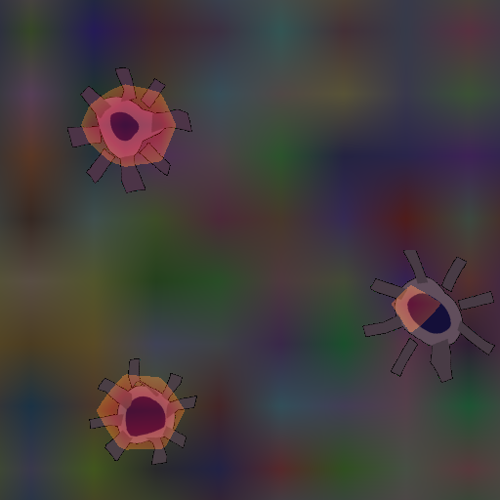
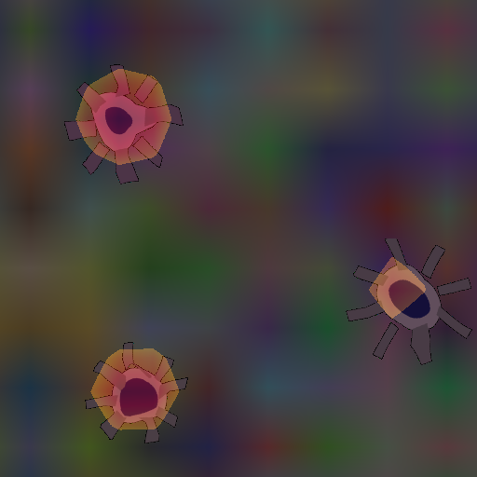
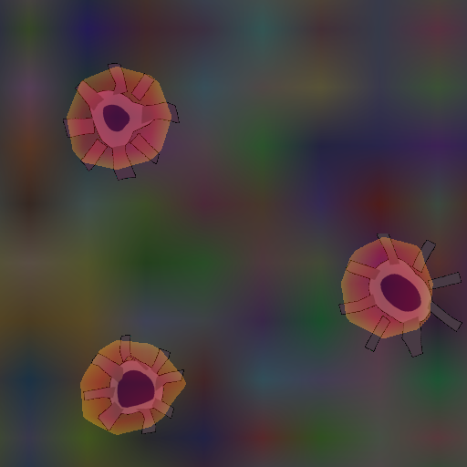
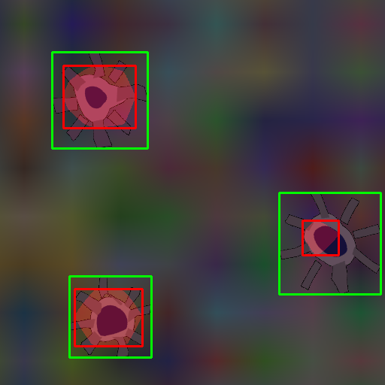
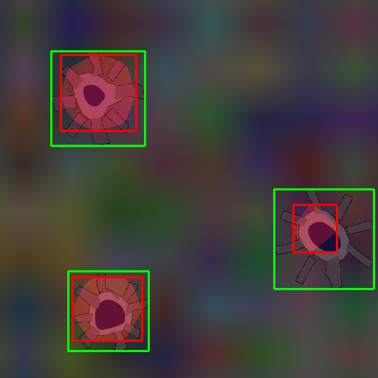
Qualitative analysis: SYNTHETIC – 3 instances
CAM (test103)
MinMaxCAM
ScoreCAM
Notes:
Same conclusions as for 2 instances.

Slide 26
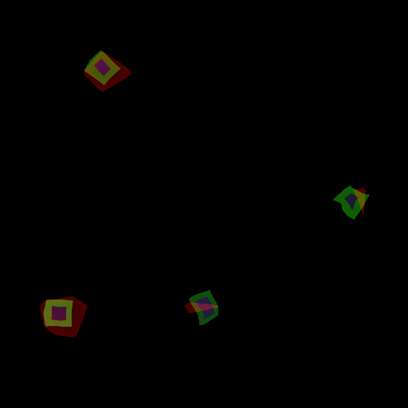
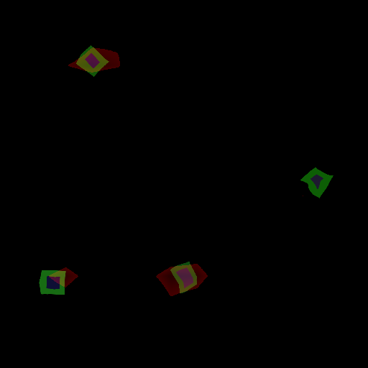
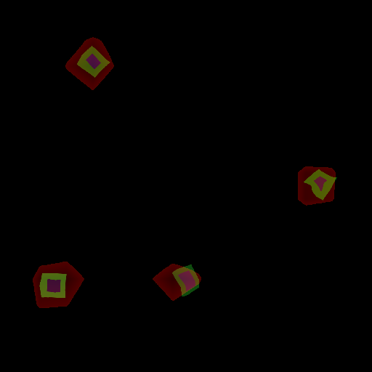
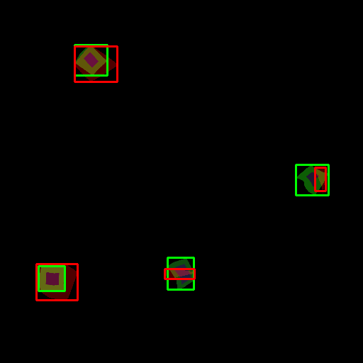
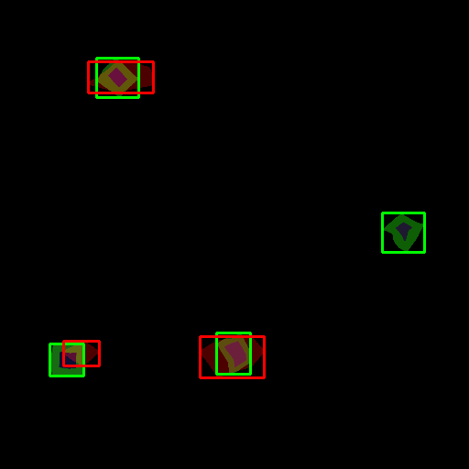
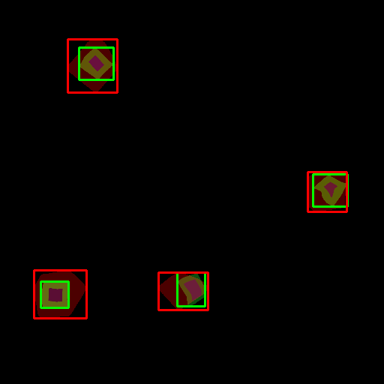
Qualitative analysis: SYNTHETIC – 4 instances
CAM (test130)
MinMaxCAM
ScoreCAM
Notes:
Smaller object instances are more challenging to localize. Easier to miss.
This example shows better-than-average performance
MinMaxCAM: more regularization may be needed
ScoreCAM: again better at capturing instances

Slide 27
Next steps

Slide 28
Next steps
CAM method benchmarking for ImageNet-1k dataset
Localization improvements using iterative bounding box extraction
Conclusions

Slide 29



Slide 30
Backup

Slide 31
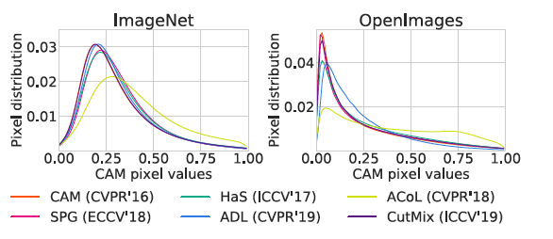
CAM pixel value distributions
Example from Choe et al., 2020b
CAM pixel value distributions (E.g. figure 13 in WSOL evaluation paper)

Slide 32
Cumulative distribution function (CDF)
To be investigated if useful
CDF of what?
Pixel values? (same as pixel distribution slide)

